Slide 1
Boost & Power-Up
Manager
By Andreu Landa Muñoz

Slide 2
Index
Introduction
What are Power-Ups
First Power-Ups
Power-Ups in Arcade Games
Power-Ups & Boost in RPG (Attributes/Stats)
Boost types
Code implementation
Conclusion
Info Links

Slide 3
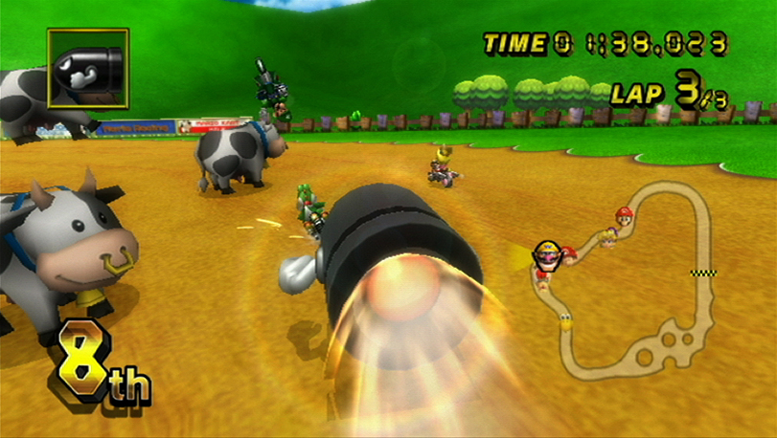

Introduction
Power-Ups are items that benefits temporarily or permanent the player
Temporary
Permanent
Bullet Bill - Mario Kart
Bomberman Power-Up

Slide 4
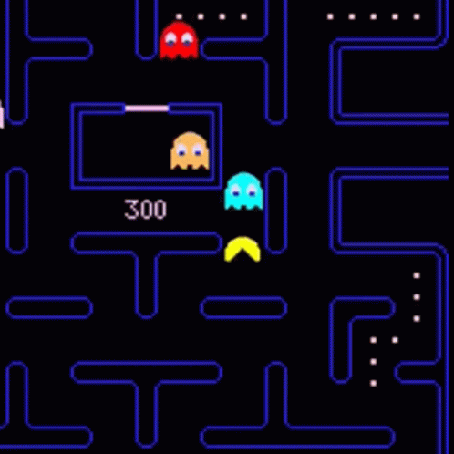
First Power-Ups
First game that implemented Power-Up mechanics was Pac-Man, each map have 4 Power Pellets.
Pacman picking a Power Pellet

Slide 5
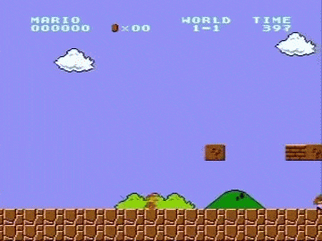

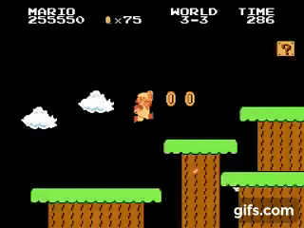
Super Mario Bros
In Super Mario Bros there were more than 1 Power-Ups in the game, was the first game that implement more than 1 type of Power-Up and it was successful
Super Mushroom
Starman
Fire Flower

Slide 6
Power-Ups in arcade games

Slide 7
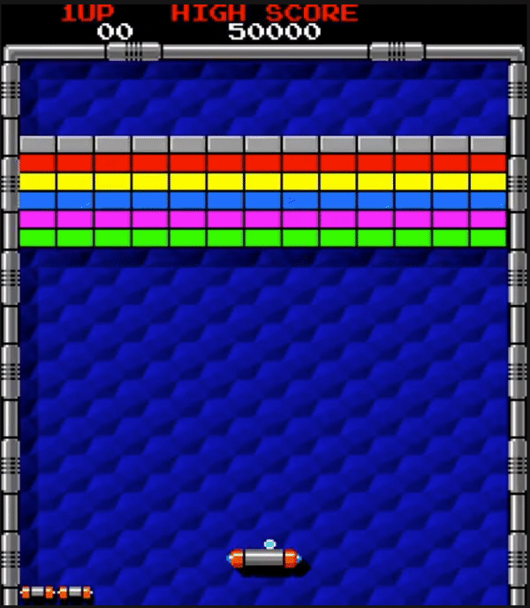
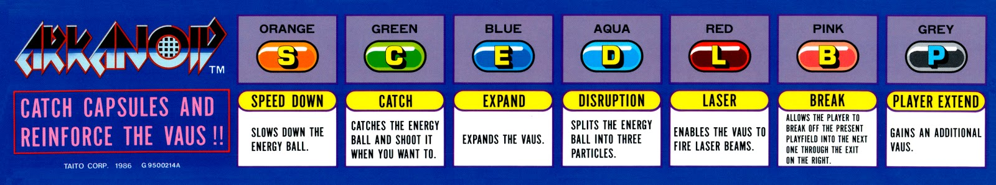
Arkanoid
Arkanoid Power-Ups description
Arkanoid Gameplay GIF

Slide 8
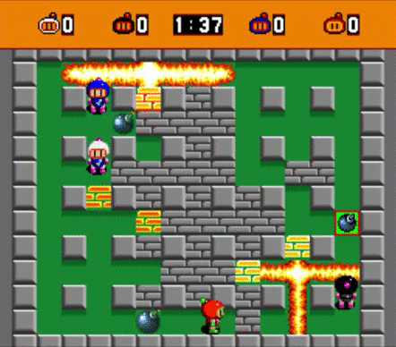

Bomberman
Bomberman Power-Ups
Bomberman Gameplay GIF

Slide 9
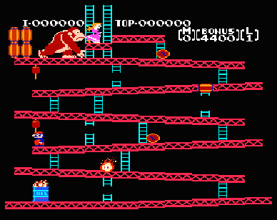

Donkey Kong
Hammer Power-Up
Donkey Kong Gameplay GIF

Slide 10
Power-Ups & Boost in RPG

Slide 11
Power-Ups are very important in role playing games, character in this genre have different attributes that can improve while you are playing gaining experience or getting objects

Slide 12
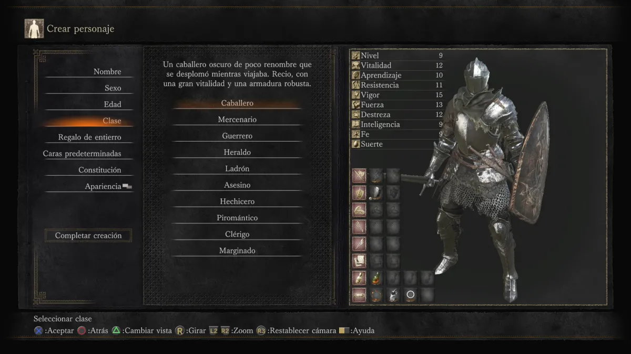
Dark Souls
Class Select - Dark Souls 3

Slide 13
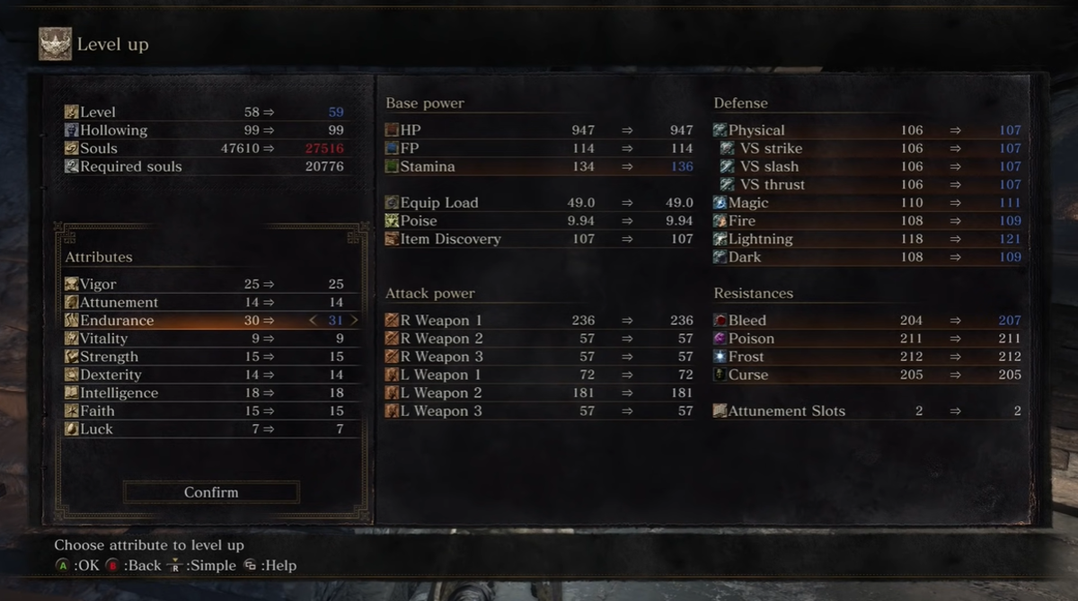
Dark Souls
Level Up Menu - Dark Souls 3

Slide 14
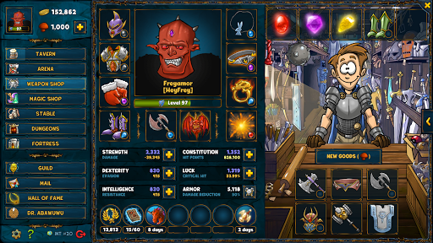
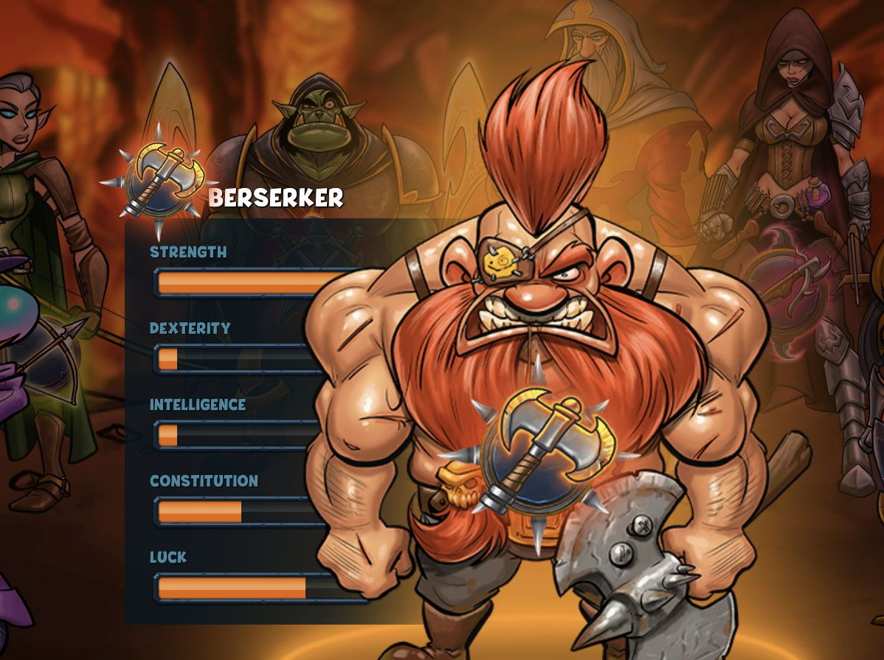
Shakes & Fidgets
Choosing Class
Weapon Shop Menu

Slide 15
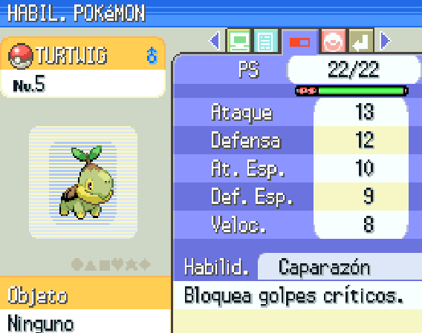
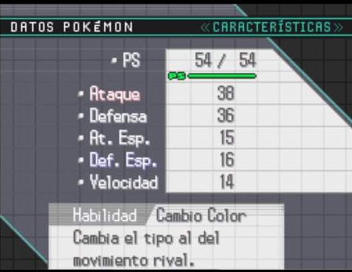
Pokemon
Pokemon’s Menu - Pokemon Diamond
Pokemon’s Menu - Pokemon Black

Slide 16
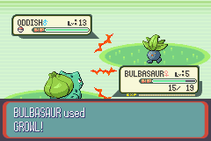
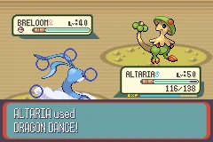
Pokemon
Debuffs enemy pokemon
Buffs ally pokemon

Slide 17
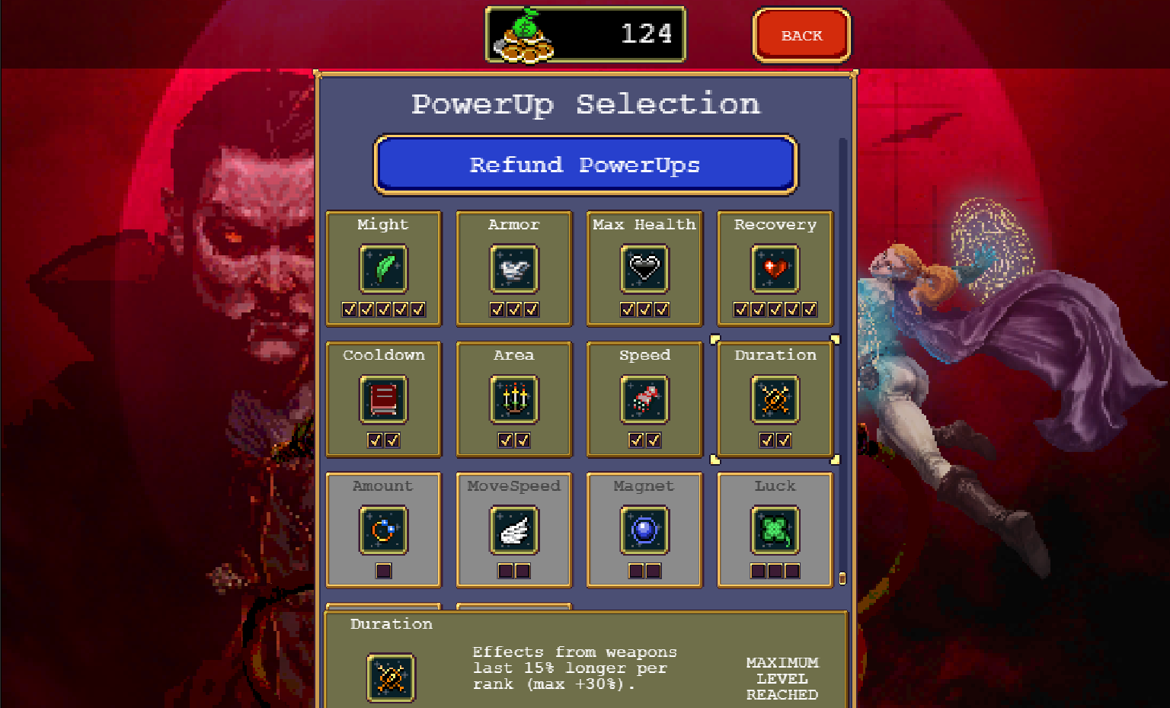
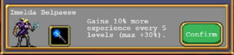
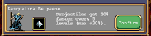
Vampire Survivor
Characters boost
Power-Up menu

Slide 18
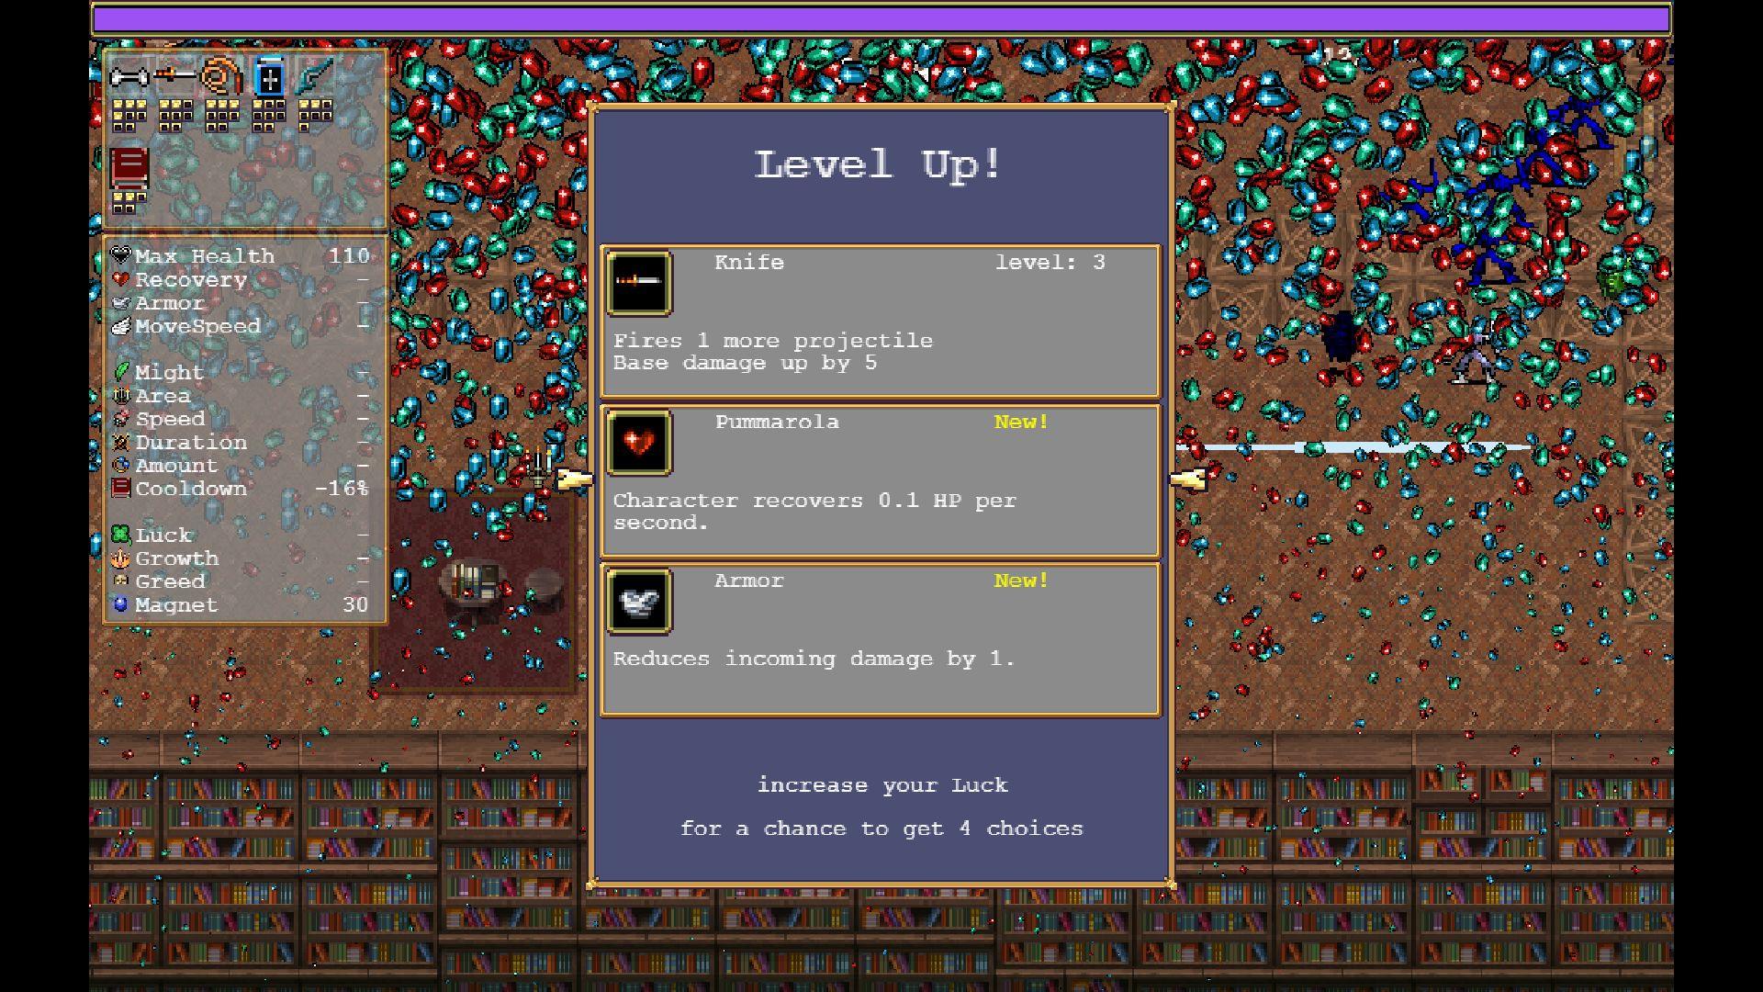
Vampire Survivor
Level Up Menu
Player Stats

Slide 19
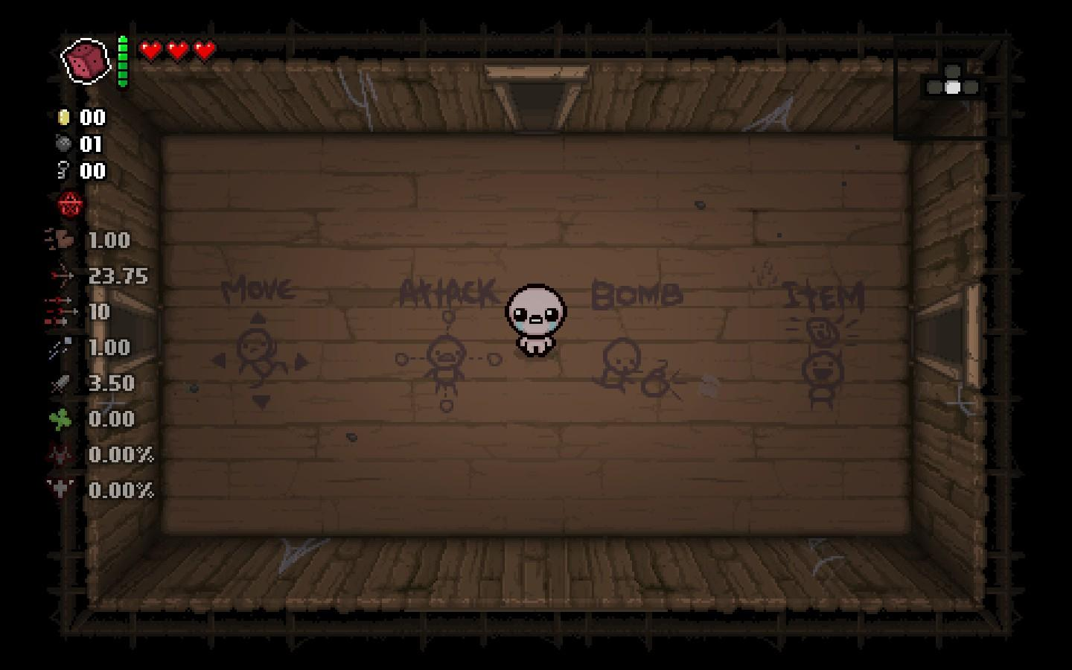
The Binding of Isaac
In-game Picture

Slide 20
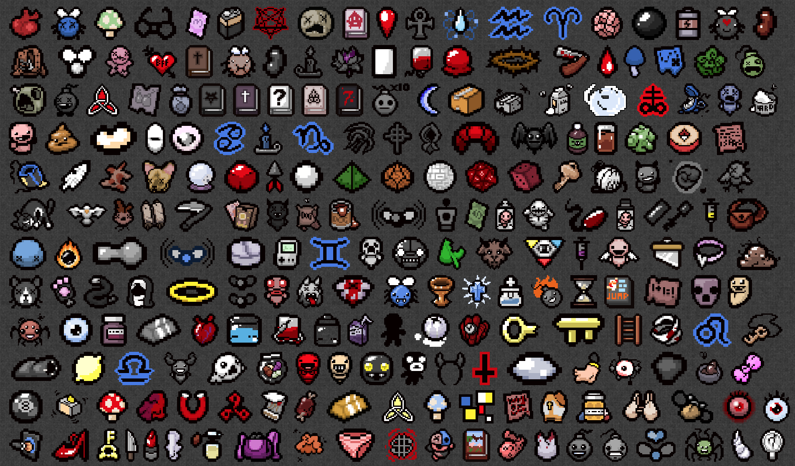
The Binding of Isaac
Binding of Isaac Power-Ups

Slide 21
Boost Types

Slide 22


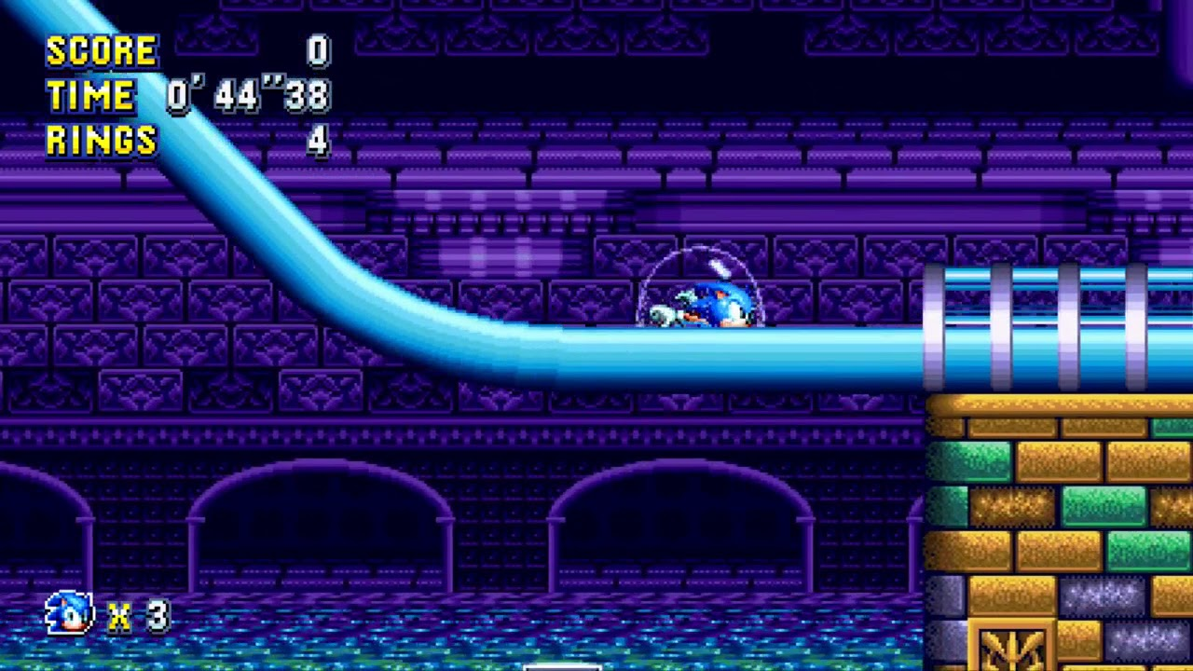
Offensive
Hammer Power-Up - Donkey Kong
Fire Flower - New Super Mario Bros
Defensive
Laurel - Vampire Survivor
Bubble Shield - Sonic Mania

Slide 23



Evasive
Skate - Bomberman
Mushrooms - Mario Kart
Life/Health
1 Up- New Super Mario Bros
Heart Container - Legend of Zelda

Slide 24
Code Implementation

Slide 25
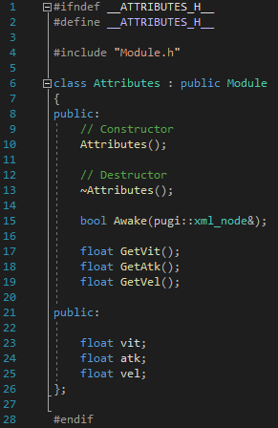
Attributes.h

Slide 26
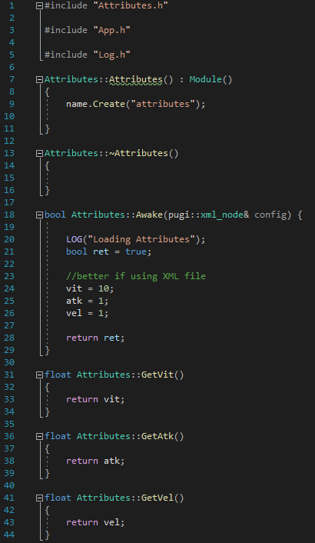
Attributes.cpp

Slide 27
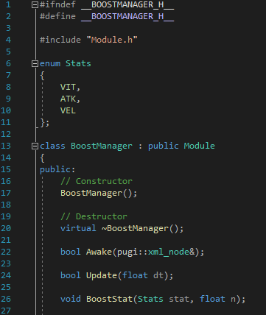
BoostManager.h

Slide 28
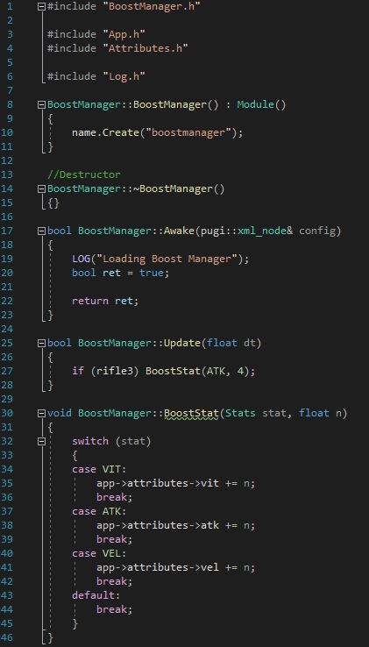
BoostManager.cpp

Slide 29
Class Assignment

Slide 30
Group up with your project team
Decide what attributes will have the characters in your game
Think about what types of power-ups or items will you implement and what will they do
And how will you improve character’s attributes (coins, leveling, only build…)

Slide 31
Conclusion

Slide 32
Info Links
GitHub: https://github.com/Landama01/Boost-Power-Up-Manager-research
Power-Ups: https://hmong.es/wiki/Power-up
Attributes: https://en.wikipedia.org/wiki/Attribute_(role-playing_games)

